Slide 1


University Management
System
The University Management System is a Java project developed using NetBeans and JFrames. It is designed to streamline the administrative processes of a university, providing a centralized platform for managing student records, course information, and other relevant data.

Slide 2
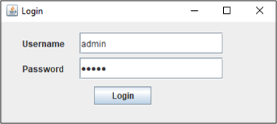
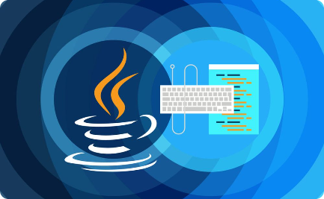
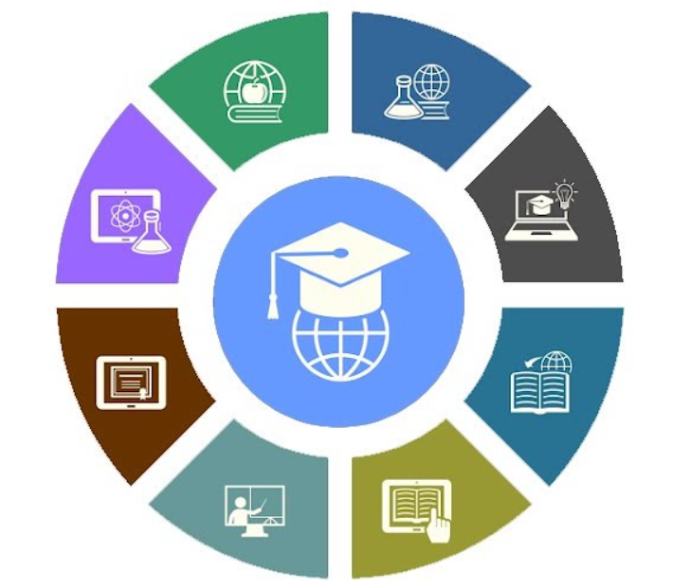
Objective
Goals
Java Application
Effective Design
The project's objective is to establish goals for university management processes, ensuring smooth functioning and structured operations.
The objective is to develop the system using Java, utilizing its robust features for efficient and reliable performance.
The goal is to create a well-designed system that enhances productivity and user experience for administrators.

Slide 3
Motivation
Enhanced Efficiency
Improved Accessibility
Enhanced Data Security
Developing the system is motivated by the desire to enhance the overall efficiency of university management, reducing manual work and streamlining processes.
Accessibility is a key motivation, aiming to provide easy access to academic and administrative resources for all users.
Motivated by the need to implement robust data security measures, ensuring the protection and privacy of sensitive information within the university system.

Slide 4
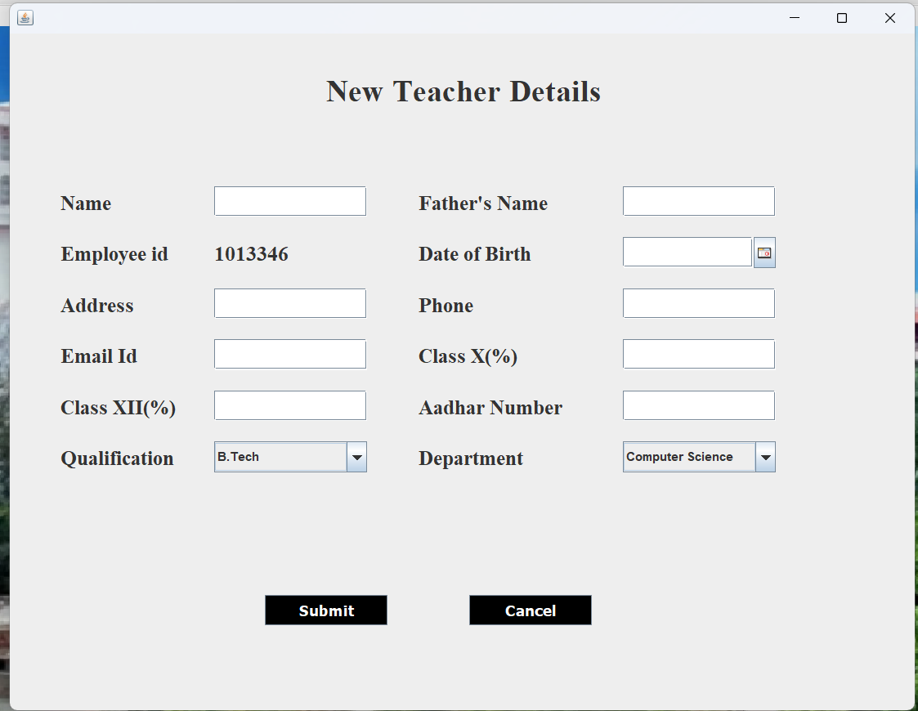
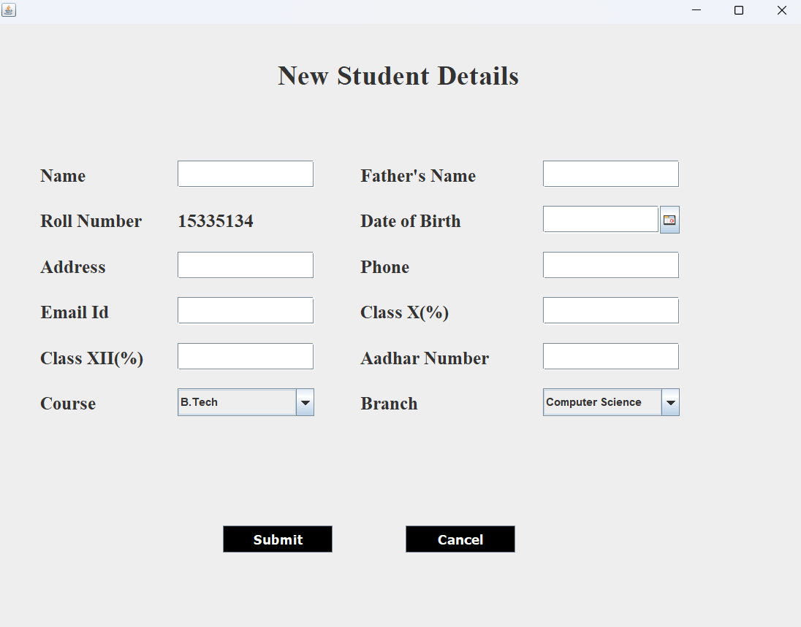
Problem Definition
The university management system project aims to solve the problem of inefficient and manual administrative processes in universities.
Currently, many universities rely on paper-based systems for tasks such as student enrollment, fee management, and record keeping.
These manual processes are time-consuming, prone to errors, and lack scalability. Additionally, the lack of a centralized system makes it difficult for different departments to communicate and share information effectively.

Slide 5


Implementation Details
1
Programming language:
Java
2
Frontend:
Netbeans
3
Backend:
MySQL
4
Concepts Used:
Classes
Objects
Inheritance
Abstraction
Polymorphism
Encapsulation

Slide 6



Conclusion
The university management system has been a significant achievement in administrative processes and enhancing efficiency in the university's operations.
Through the use of Java and NetBeans, we have successfully developed a user-friendly system that allows for easy management of student records and other administrative tasks.
The project has demonstrated the power of technology in improving the overall functioning of the university, reducing manual work, and increasing accuracy in data management.

Slide 7


